Slide 1
Functionally profiling metagenomes & metatranscriptomes at species-level resolution (with HUMAnN2)
Eric Franzosa, Ph.D.
Research Scientist in Curtis Huttenhower’s Lab
Pathway Tools Workshop
14 Feb 2018
Harvard T. H. Chan School of Public Health
Department of Biostatistics

Slide 2
introduction

Slide 3
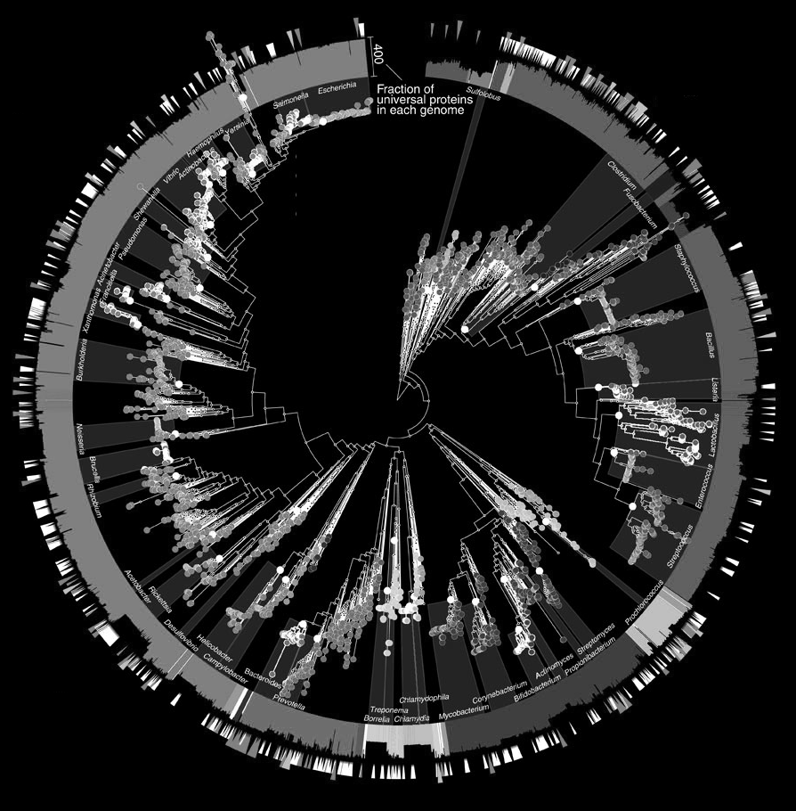
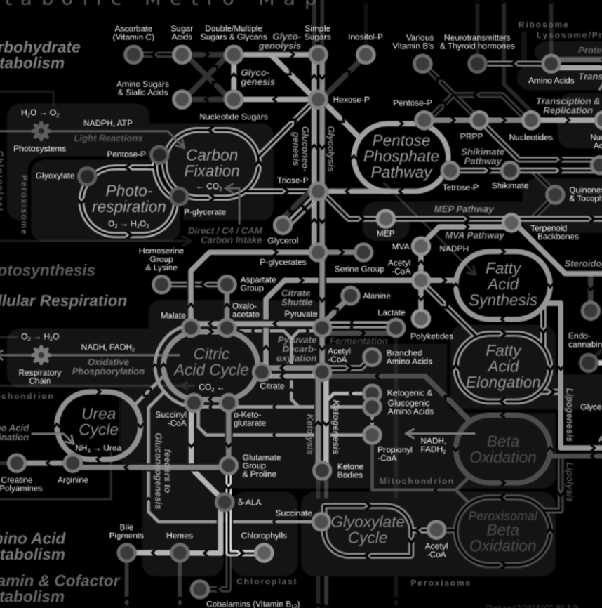
The two big questions of microbial community profiling:
1
2
What are they doing?
Who is there?
(taxonomic profiling)
(functional profiling)
Increasingly we want to answer these questions together. Existing methods tend to target one question or the other.

Slide 4
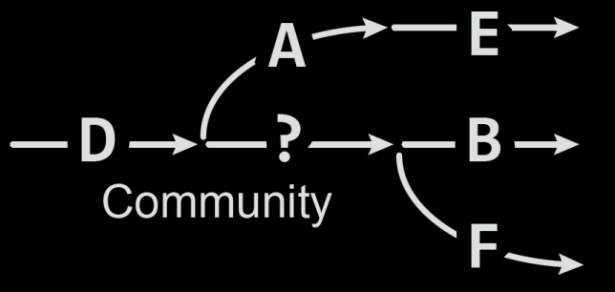
Traditional, reference-based functional profiling of meta’omes
Quality-controlled
metagenome or
metatranscriptome
(meta’ome) as input
Translated search (~blastx) against a comprehensive protein seq. database
Collapse gene abundance to gene sets / reconstruct metabolic pathways
(e.g. HUMAnN1)
Issue #1:
Translated search is slow
Issue #2:
Comprehensive search is slow and vulnerable to spurious hits
Issue #3:
No taxonomic resolution (typically)

Slide 5
A new approach to functional profiling: tiered read mapping with HUMAnN2
(1st tier)
(2nd tier)
(3rd tier)
http://metaref.org
Quality-controlled meta’ome as input (as before)
Rapidly identify species in the community (via MetaPhlAn2)
Nucleotide map all reads vs. pangenomes of identified species
Translated search unmapped reads vs. comprehensive protein db
Save “novel” reads for external assembly
http://huttenhower.sph.harvard.edu/humann2

Slide 6
validation

Slide 7
HUMAnN2 synthetic evaluation (genes)
…and is 3x faster
2.1 hours
0.7 hours
(10M reads,
8 cores)
HUMAnN2 tiered search is more accurate…
Comprehensive search suffers from spurious hits
...and
provides
accurate
per-species
quantification!
Compare exp. vs. obs. gene abundance
1x
Staggered abundance
~0.1x to 100x coverage
Synthetic human gut metagenome (top 20 species)

Slide 8
Performance on human metagenomes
~60% of reads align before translated search
~15% more reads align during translated search (total ~75%)
Applied HUMAnN2’s tiered search to profile 2,500 human metagenomes (HMP1-II, six major body sites)
Pangenome search tier
1-2 orders of magnitude faster
than comprehensive
translated search
DIAMOND w/
comprehensive
protein db
bowtie2 w/
sample-specific
pangenome db
hmpdacc.org

Slide 9
output

Slide 10
HUMAnN2: stratified output
UniRef90_R6K3Z5: IMP dehydrogenase | 600.95
UniRef90_R6K3Z5: IMP dehydrogenase|Bacteroides_caccae | 234.76
UniRef90_R6K3Z5: IMP dehydrogenase|Bacteroides_dorei | 107.38
UniRef90_R6K3Z5: IMP dehydrogenase|Bacteroides_ovatus | 92.18
UniRef90_R6K3Z5: IMP dehydrogenase|Bacteroides_stercoris | 83.95
UniRef90_R6K3Z5: IMP dehydrogenase|Bacteroides_vulgatus | 57.27
UniRef90_R6K3Z5: IMP dehydrogenase|unclassified | 25.41
Σ

Slide 11
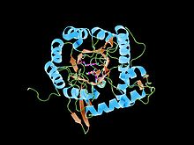
HUMAnN2: stratified output
UniRef gene cluster
Gene name
Total gene abundance (RPK)
UniRef90_R6K3Z5: IMP dehydrogenase | 600.95
UniRef90_R6K3Z5: IMP dehydrogenase|Bacteroides_caccae | 234.76
UniRef90_R6K3Z5: IMP dehydrogenase|Bacteroides_dorei | 107.38
UniRef90_R6K3Z5: IMP dehydrogenase|Bacteroides_ovatus | 92.18
UniRef90_R6K3Z5: IMP dehydrogenase|Bacteroides_stercoris | 83.95
UniRef90_R6K3Z5: IMP dehydrogenase|Bacteroides_vulgatus | 57.27
UniRef90_R6K3Z5: IMP dehydrogenase|unclassified | 25.41
Σ
Per-species & unclassified stratifications
HUMAnN1
PathoLogic?
MetaCyc pathway
Pathway abundance & coverage
PWY-7221: GTP biosynthesis | 200.35 | 1
PWY-7221: GTP biosynthesis|Bacteroides_caccae | 120.23 | 1
PWY-7221: GTP biosynthesis|Bacteroides_dorei | 11.12 | 0

Slide 12
core metabolic pathways of the
human microbiome

Slide 13
Core metabolic pathways of the human microbiome (HMP1-II)
Core to a body site = found in 75% of subjects + strong taxonomic attribution
Type 1: Housekeeping functions manifest as core pathways in all body sites
Type 2: Core pathways enriched in the human microbiome (rare elsewhere)
Type 3: Core pathways enriched in specific body sites/areas
hmpdacc.org

Slide 14
contributional
diversity

Slide 15
Quantifying the diversity of species contributing a function within and across subjects
low
between-subject diversity
high
low
simple,
conserved
simple,
variable
within-subject diversity
complex,
conserved
complex,
variable
high

Slide 16
HUMAnN2 reveals unusual “relative expression” in paired metatranscriptomes & metagenomes
Sucrose degradation follows a complex attribution pattern across ~200 human gut metagenomes…
In collaboration with
the STARR Consortium
& HPFS cohort
…but its expression can be dominated by a single species in paired gut metatranscriptomes!

Slide 17
strain variation

Slide 18
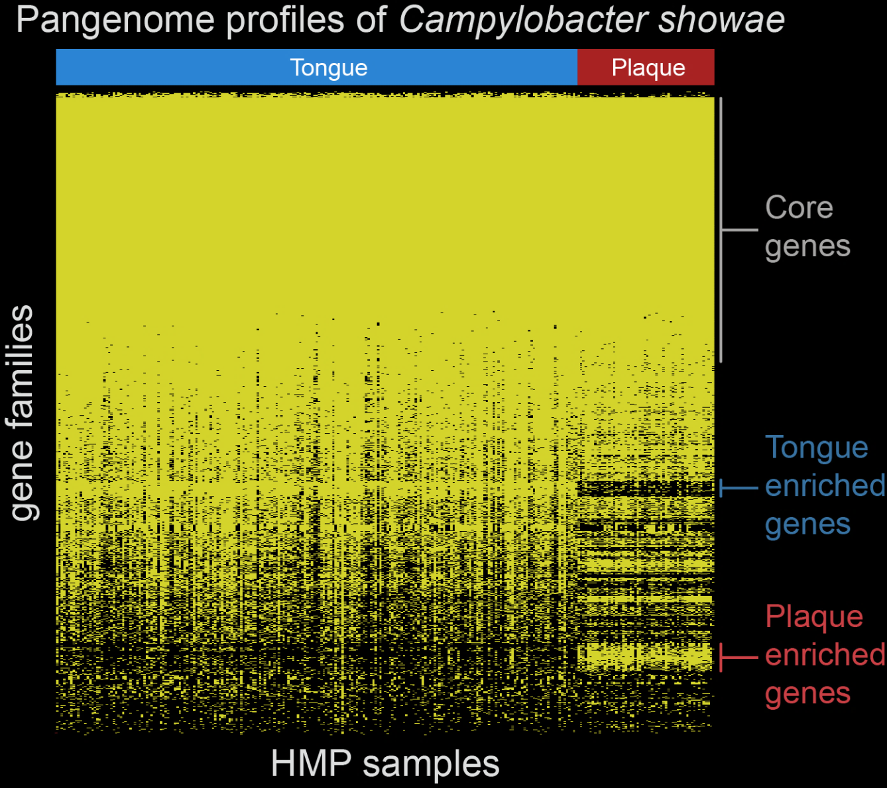
HUMAnN2 gene family profiles identify niche-adapted subspecies
This example confirmed by SNP-level strain analysis
Advantages of gene-level strain analysis:
Works with lower fold coverage (1x)
Can immediately interpret functions of present/absent genes
HUMAnN2 gene profiles can act as input for PanPhlAn strain tracking: http://segatalab.cibio.unitn.it/tools/panphlan

Slide 19
wrap-up

Slide 20
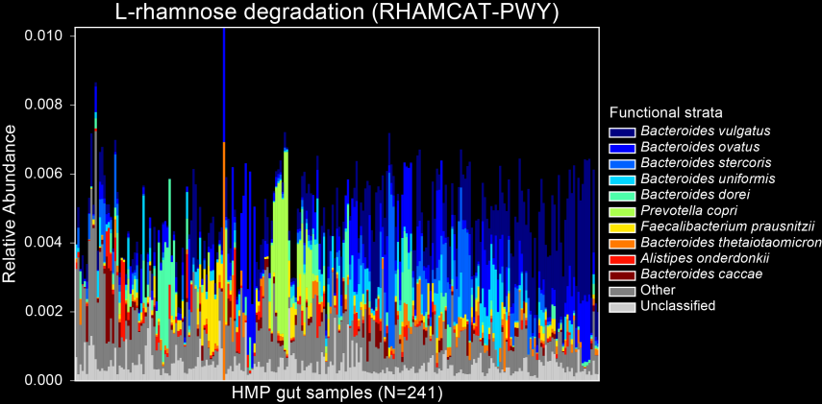
Take-home messages
HUMAnN2 implements a
tiered approach to faciliate
meta’omic functional profiling
This approach is more accurate
& much faster than traditional comprehensive meta’omic search
Results stratify by species for free:
Answering “who’s there?” and
“What are they doing?” in tandem

Slide 21
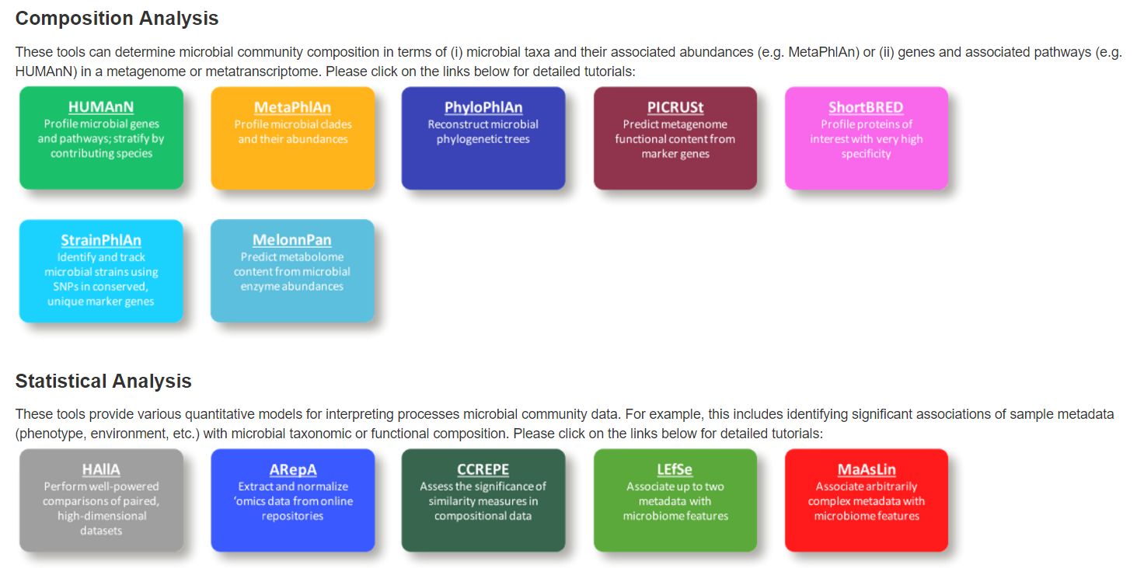
Getting HUMAnN2
Available now!
Install via source, pip, homebrew
Detailed user manual
Quick-start tutorial & demo
Active user group
http://huttenhower.sph.harvard.edu/biobakery
First hit when you google “biobakery”

Slide 22
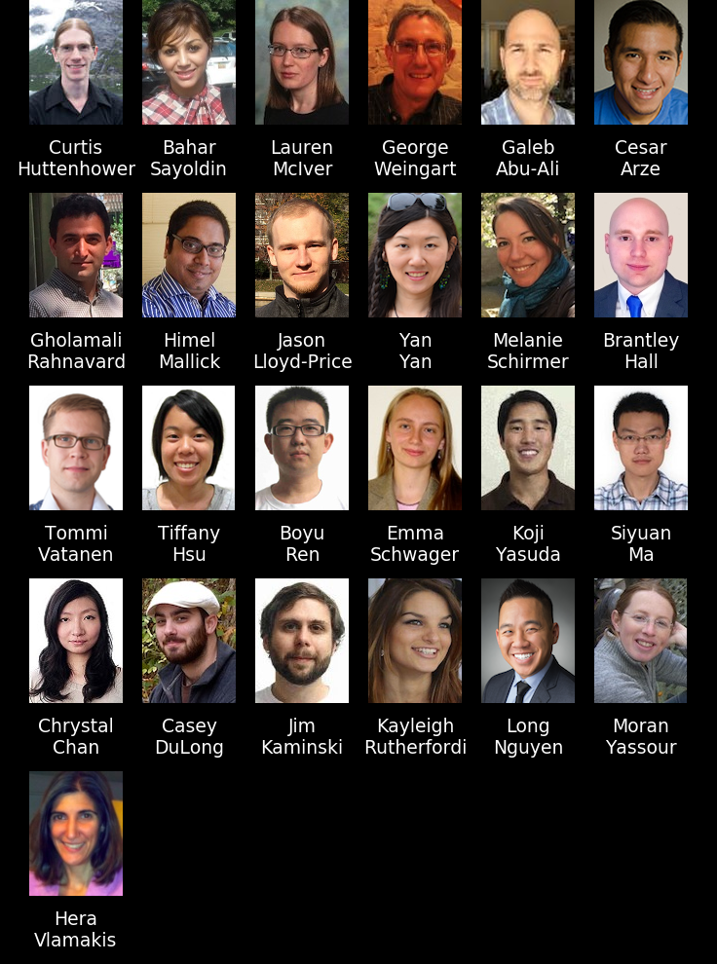
Acknowledgements
Funding for the lab
HUMAnN2 collaborators
Rob Knight
Luke Thompson
Greg Caporaso
Karen Schwarzberg
Nicola Segata
Duy Tin Truong
Human Microbiome Project
Owen White
Joe Petrosino
George Weinstock
Karen Nelson
Lita Proctor
Erica Sodergren
Anthony Fodor
Marty Blaser
Jacques Ravel
Pat Schloss
Sahar Abubucker
Brandi Cantarel
Alyx Schubert
Mathangi Thiagarajan
Beltran Rodriguez-Mueller
Makedonka Mitreva
Yuzhen Ye
Mihai Pop
Larry Forney
Barbara Methe
↑ The Huttenhower Lab
http://huttenhower.sph.harvard.edu

